Slide 1

UNIVERSITY INSTITUTE OF ENGINEERING
COMPUTER SCIENCE ENGINEERING
Master of Engineering
ADVANCED DATA STRUCTURES
&
ALGORITHMS
(23CSH-622)
INTRODUCTION
DISCOVER . LEARN . EMPOWER

Slide 2

ADVANCED DATA STRUCTURES
&
ALGORITHMS
(23CSH-622)
By : Dr. Ranjit Singh (E10947)
www. cuchd.in Campus : Gharaun, Mohali

Slide 3
TOPICS TO BE COVERED
INTRODUCTION
CONSTRUCTING A B-TREE
INSERTING IN A B-TREE
DELETING FROM A B-TREE
DIFFERENCE BETWEEN B & B+ TREES

Slide 4
Introduction to B tree
B tree is used to index the data and provides fast access to the actual data stored on the disks since, the access to value stored in a large database that is stored on a disk is a very time consuming process.
One of the main reason of using B tree is its capability to store large number of keys in a single node and large key values by keeping the height of tree relatively small.

Slide 5
B-Tree
A B-Tree of order m is an m-way tree(i.e. a tree where each node may have up to(maximum) m children) in which:
The maximum number of keys in each non-leaf node is one less than the number of its children. (m-1)
All leaves are on the same level.
All non-leaf(internal) nodes and external nodes (leaf) except the root have at least Гm/2˥ children or in other words Гm/2˥ -1 keys.
Suppose m=5.
Number of keys in internal node is 1 less than its number of children.
All internal node except the root have at least Г5/2˥ = 3 children (or at least 2 keys)
A leaf node contains not more than 4 keys.
Leaf node must contain at least Г5/2˥ - 1 = 2 keys.

Slide 6


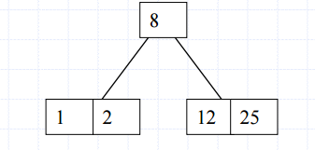
Constructing a B-Tree
Suppose we start with an empty B-tree and keys arrive in the following order:
1, 12, 8, 2, 25, 6, 14, 28, 17, 7, 52, 16, 48, 68, 3, 26, 29, 53, 55, 45
Construct a B-tree of order 5. That means each node can have upto 5 childrens.

Slide 7
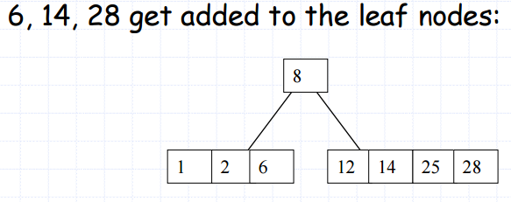

Constructing a B-Tree(contd..)

Slide 8
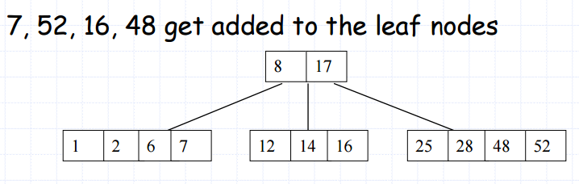
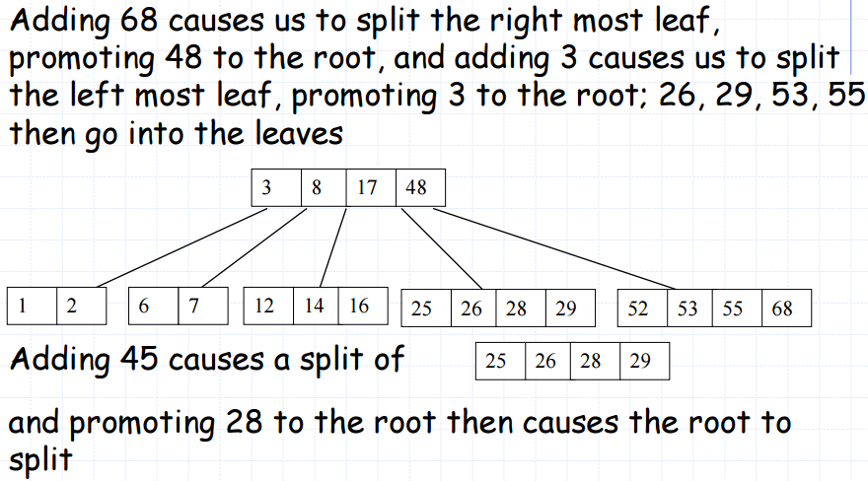
Constructing a B-Tree(contd..)

Slide 9
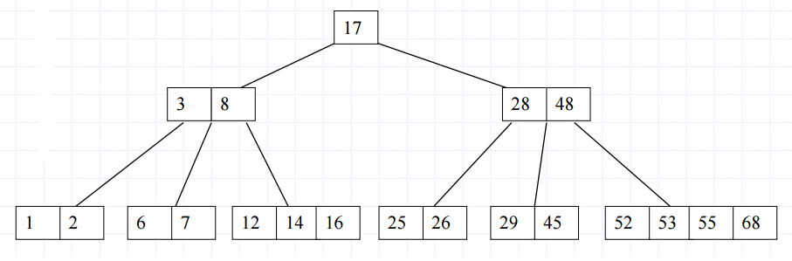
Constructing a B-Tree(contd..)

Slide 10
Inserting into a B-Tree
Attempt to insert the new key into a leaf.
If this would result in that leaf becoming too big, split the leaf into 2, promoting the middle key to the leaf’s parent.
If this would result in the parent becoming too big, split the parent into two, promoting the middle key.
This strategy must have to be repeated all the way to the top.
If necessary, the root is split in two and the middle key is promoted to a new root, making the tree one level higher.

Slide 11
Practice???
B tree of order 3:
The elements to be inserted are 4, 2, 20, 10, 1, 14, 7, 11, 3, 8.
B Tree of order 4:
5, 3, 21, 9, 1, 13, 2, 7, 10, 12, 4, 8

Slide 12
Deletion from B-Tree
During insertion, the key always goes into a leaf. For deletion we wish to remove from a leaf.
There are 3 possible ways we can do this:
If the key is already in a leaf node, and removing it doesn’t cause that leaf node to have too few keys, then simply remove the key to be deleted.
If the key is not in a leaf then it is guaranteed that its predecessor or successor will be in a leaf. In this case, can we delete the key & promote the predecessor or successor key to the non-leaf deleted key’s position.
If (1) & (2) lead to a leaf node containing less than the minimum number of keys then we have to look at the siblings immediately adjacent to the leaf in question:
If one of them has more than the minimum number of keys then we can promote one of its keys to the parent and take the parent key into our lacking leaf.
If neither of them has more than the minimum number of keys then the lacking leaf and one of its neighbors can be combined with their shared parent(the opposite of promoting a key) and the new leaf will have the correct number of keys; If this step leaves the parent with too few keys then we repeat the process up to the root itself, if required.

Slide 13
B+ Trees
In B Tree, Keys and records both can be stored in the internal as well as leaf nodes. Whereas, in B+ tree, records (data) can only be stored on the leaf nodes while internal nodes can only store the key values.
The leaf nodes of a B+ tree are linked together in the form of a singly linked lists to make the search queries more efficient.
B+ Tree are used to store the large amount of data which can not be stored in the main memory. Due to the fact that, size of main memory is always limited, the internal nodes (keys to access records) of the B+ tree are stored in the main memory whereas, leaf nodes are stored in the secondary memory.

Slide 14
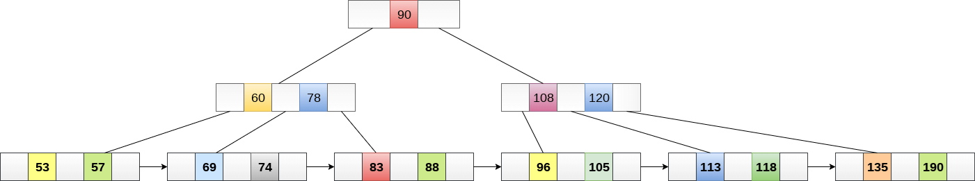
The leaf nodes of a B+ tree are linked together in the form of a singly linked lists to make the search queries more efficient.

Slide 15
Application of B & B+ Tress???
Differences between B & B+ Tress???

Slide 16
References
Li`pschutz, Seymour, “Data Structures”, Schaum's Outline Series, Tata McGraw Hill.
Data structure and algorithm by Narasimha Karumanchi.
www.tutorialspoint.com
www.geeksforgeeks.com
16

Slide 17
Books Recommended
Goodrich, Michael T., Tamassia, Roberto, and Mount, David M., “Data Structures and Algorithms in C++”, Wiley Student Edition.
Aho, Alfred V., Ullman, Jeffrey D., Hopcroft ,John E. “Data Structures and Algorithms”, Addison Wesley
Lipschutz, Seymour, “Data Structures”, Schaum's Outline Series, Tata McGraw Hill.
Gilberg/Forouzan,” Data Structure with C ,Cengage Learning.
Augenstein,Moshe J , Tanenbaum, Aaron M, “Data Structures using C and C++”, Prentice Hall of India

